Slide 1
CIRCLE IR LED
Goal: Build a circle IR led 850nm with controllable angle by using Arduino and 74HC595 or MAX 7221
By Nguyen Van Han
11/21/2021

Slide 2
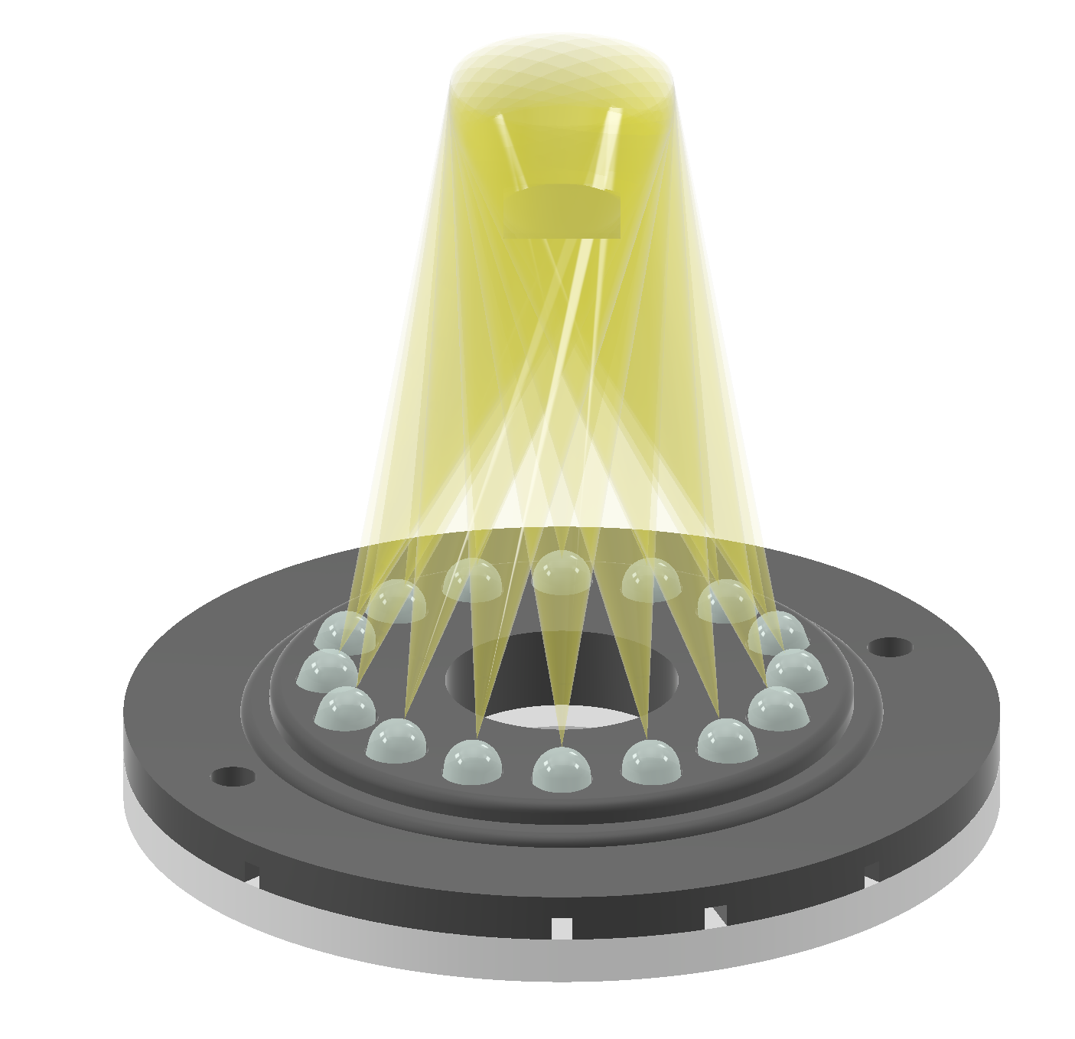
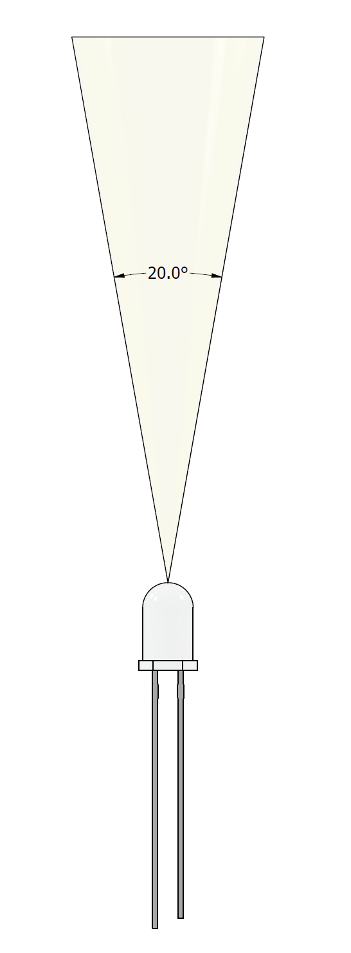
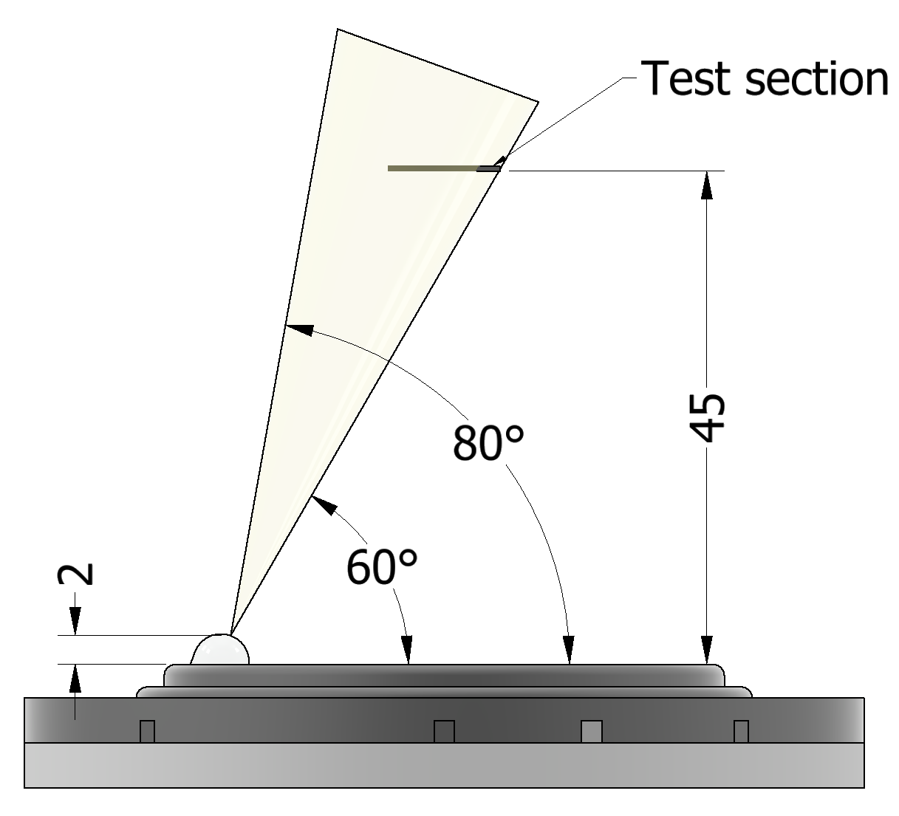
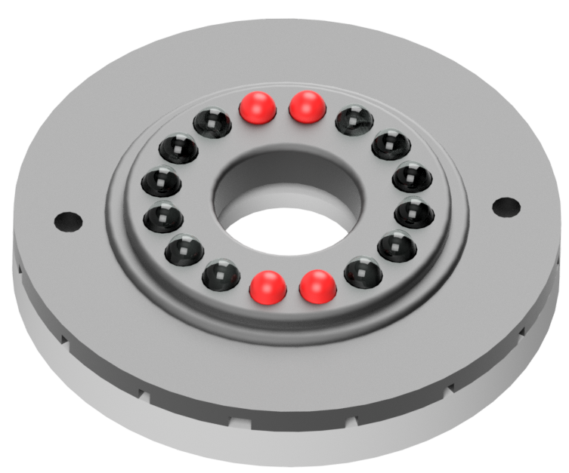
Concept Design
LED specification
Model: TSHG6210
Wavelength: 850nm
View angle: 20⁰
Diameter : 5mm
Radiant Intensity: 230

Slide 3
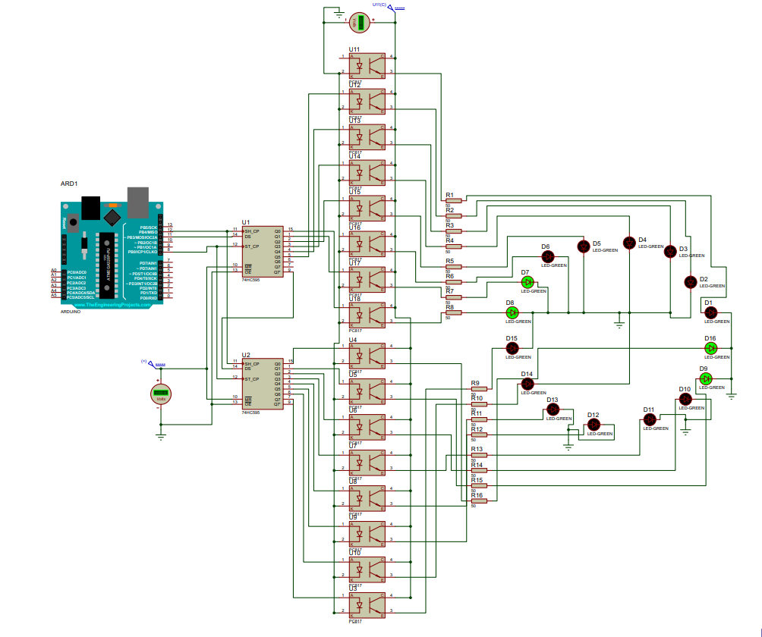
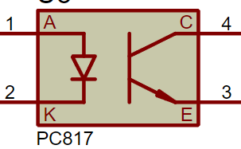
Schematic Diagram with PC817
Arduino Leonardo
2 74HC595
16 IR LED
16 50 Ohm Resistors
16 PC817

Slide 4
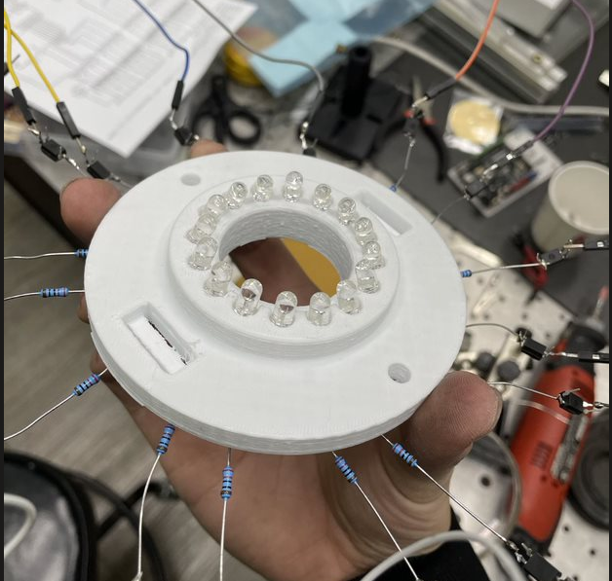
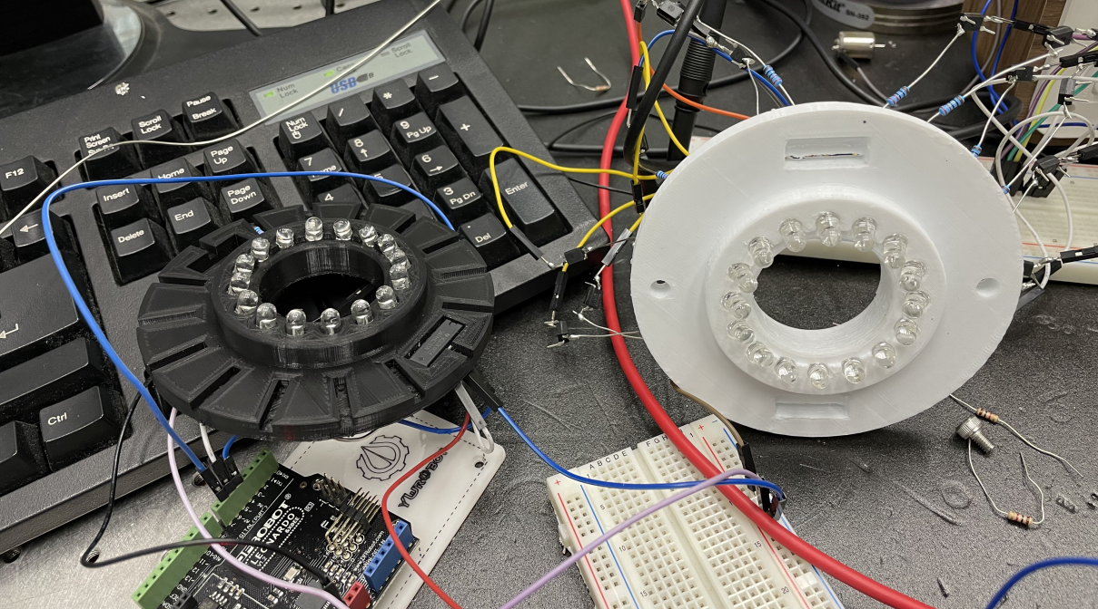
CIRCLE IR LED
3D printed model

Slide 5
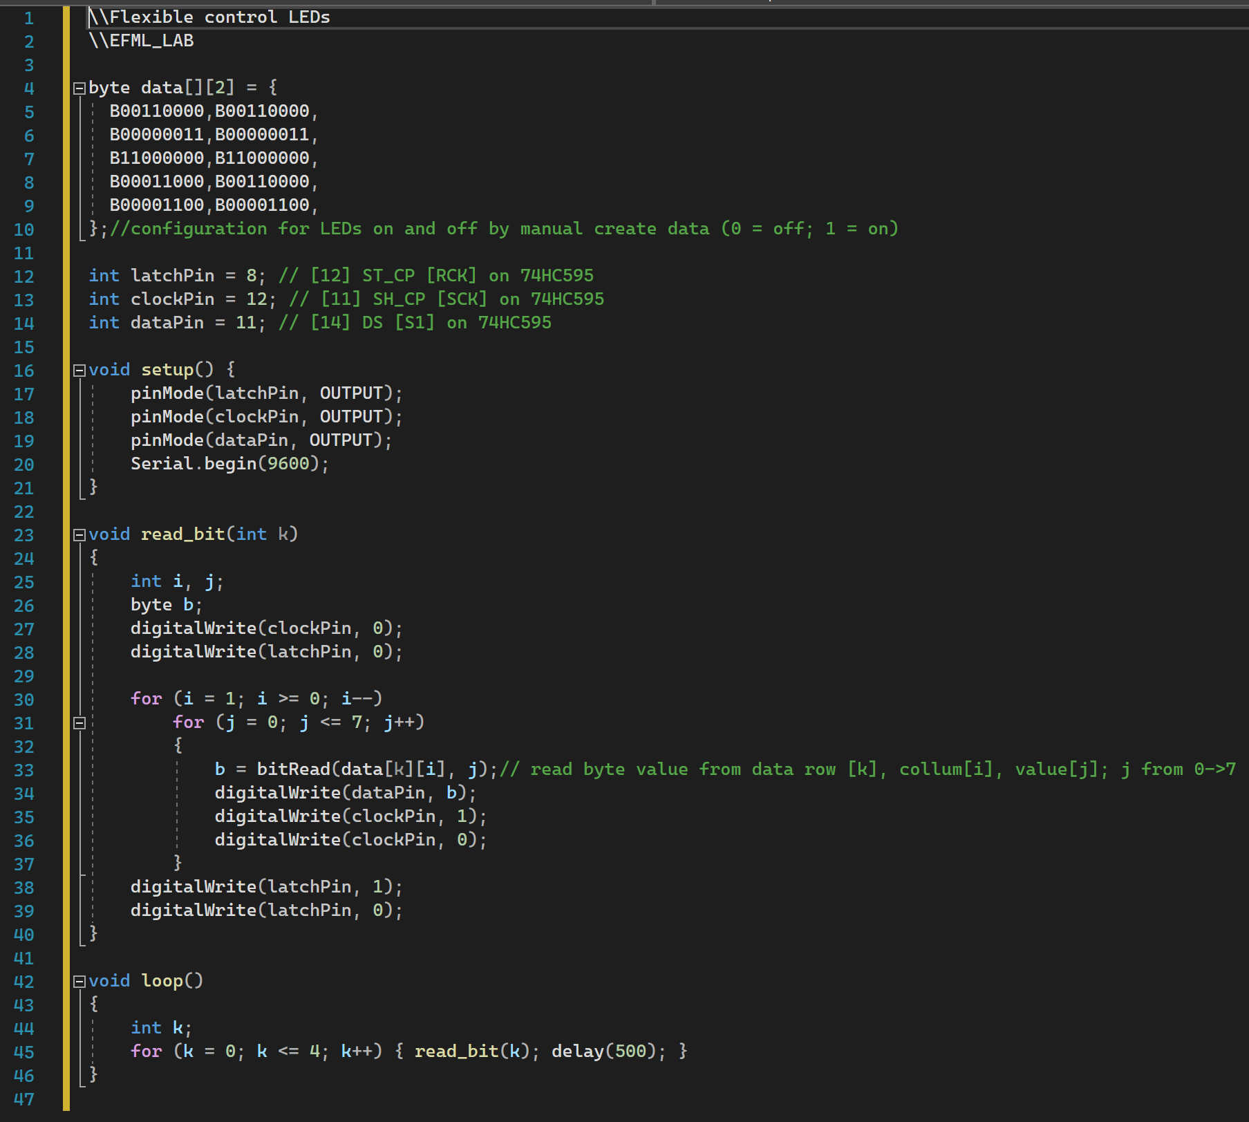
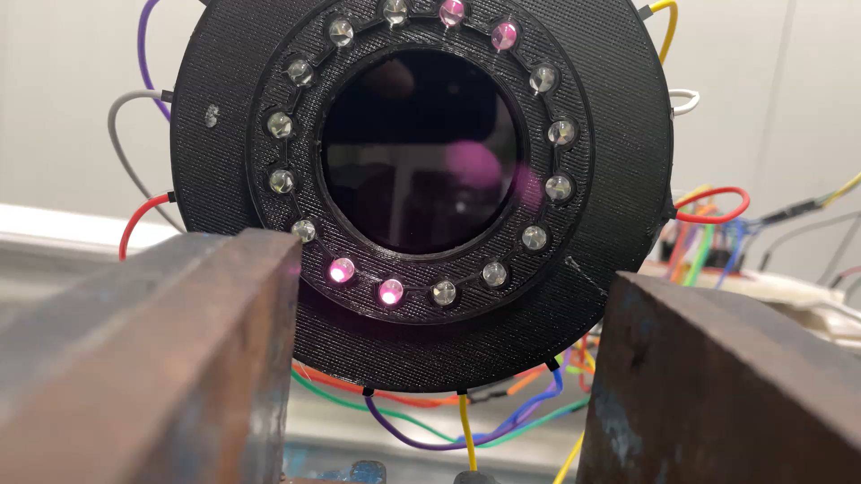
Program
Change the effect here
Change the delay here

